Slide 1
The Chaotic Behavior of Slab Avalanches
By Danny Satterthwaite

Slide 2
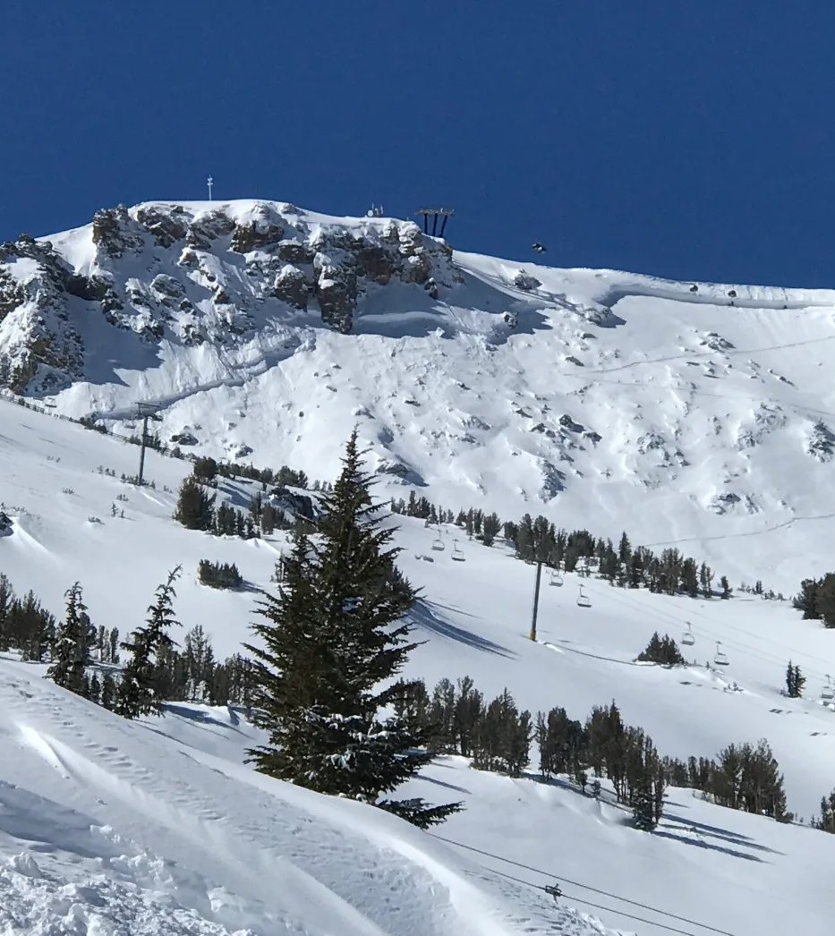
About the data
What is a slab avalanche?
The fundamental ingredients for a slab avalanche are a stratigraphic unit of relatively cohesive snow over a less cohesive weak layer.
Time series of 8062 avalanches over a 20-year period at Mammoth Mountain.
Focused on the upper cliffs slide path which limited the data to 416 points.
Notes:
- layer

Slide 3
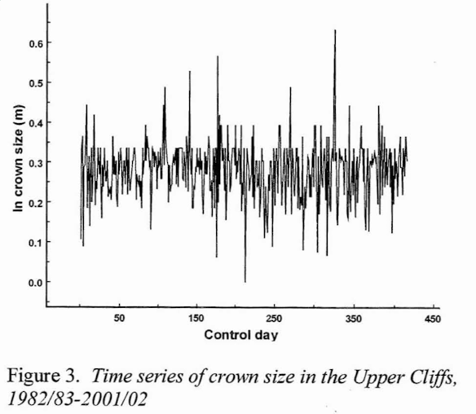
Data Collection and Analysis
The dependent variable and focus was the distribution of crown depth (size), and it was analyzed for chaos.
Collection:
Every day that it snowed, the slope was bombed to trigger an avalanche. If no avalanche occurred, crown depth = 0. If an avalanche was triggered, its crown depth was recorded.
Researchers determined there was no autocorrelation or periodicity.

Slide 4
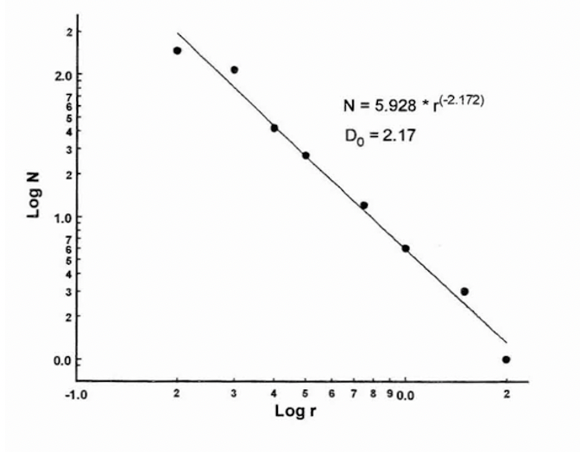
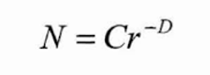
Data Exploration
The distribution of the number (N) of avalanche crown sizes larger than a certain size (r) follows a power law function of the form (where C is a constant and D is the fractal dimension):
Notes:
- Like the guest speaker

Slide 5
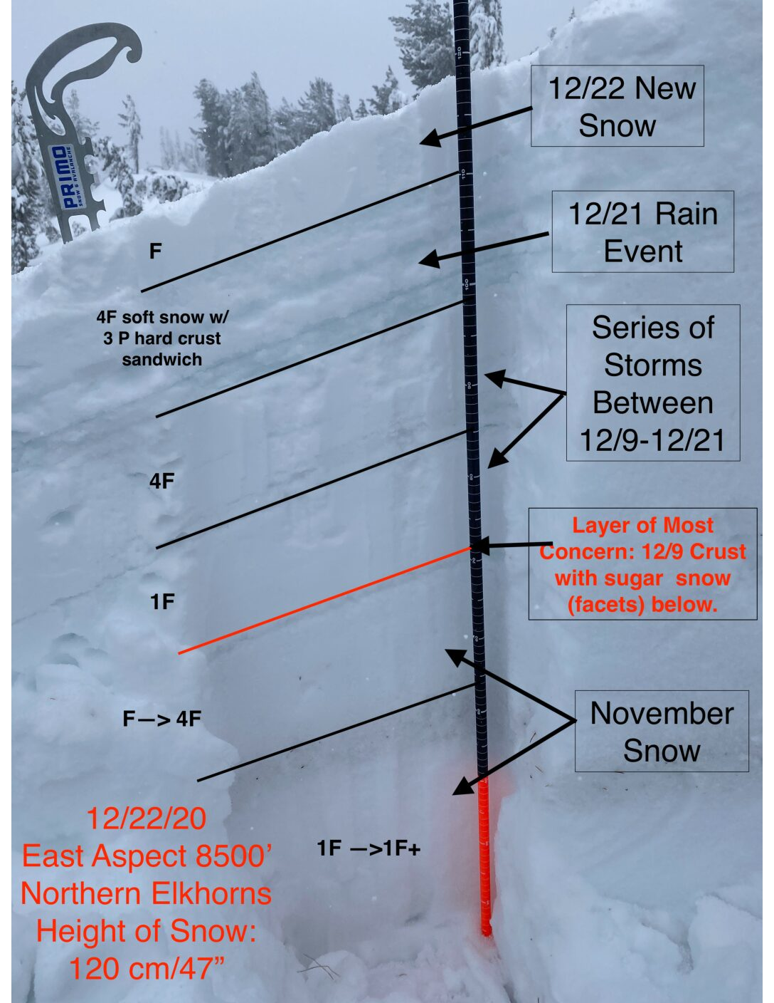
Why we expect chaotic behavior
There are many factors that determine the cohesiveness of the slab, the weak layer it slides on, and how bonded together the slab and weak layer are.
Ex: temperature, degree of evolving and becoming more compact within and between layers, density, snow crystal size, snow crystal shape, snow moisture contents and gradients.
These all change at different rates and we suspect that because of this, we will see SDIC.

Slide 6
Exploring and Constructing the attractor
No other variables collected other than crown size so used lagged values of crown size to construct the attractor.
Embedding dimension determined to be at most 3 (using false nearest neighbors' approach) and verified using the correlation dimension.
Principal component analysis was done on the time lagged crown size variables to determine the three principal axes making up the 3-embedding-dimensionional space.
Also conducted three tests for determinism.
All three tests concluded that the time series data is deterministic.
Notes:
Phase Space: represents all possible states of a dynamic system and the dimension of the phase space is the number of dependent variables
The number of dimensions necessary, ie the degrees of freedom, is the embedding dimension.
: For a three-dimensional space, you'd use two lags, plotting x(t)x(t), x(t+1)x(t+1), and x(t+2)x(t+2). Each point now represents the system at three consecutive times, providing a richer, more detailed view of its dynamics.
Pca done to reduce dimesionality and identifaly princapl axis and make the 3 uncorrelated axis ie varialbes
(to see if the present state can be determined from past states).
Using comparisons with random distributions, the Kaplan and Glass tests, and graphical analysis comparing bedding dimension and correlation dimension.

Slide 7
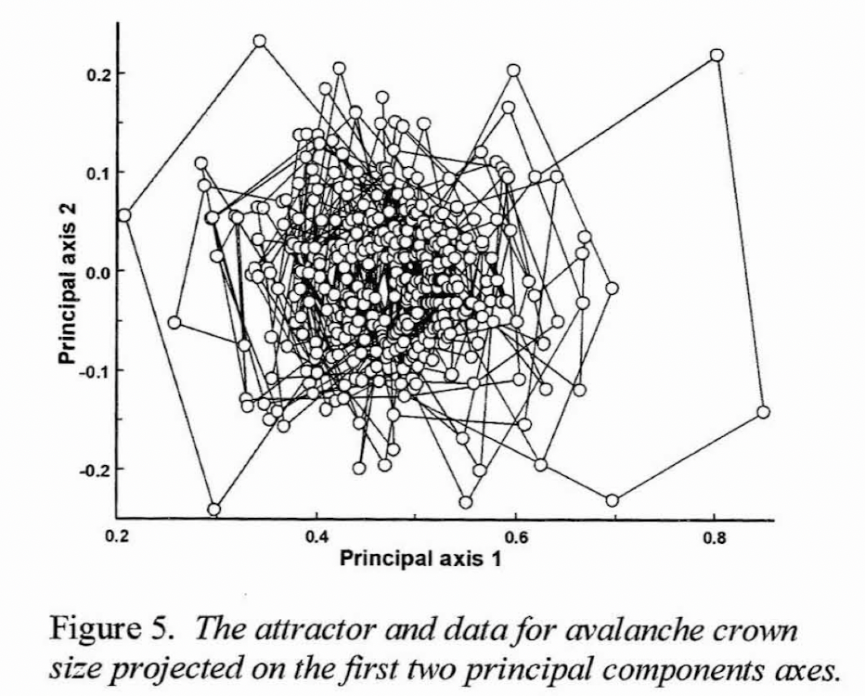
Results and The Attractor Part 1
The attractor projected onto the first two principal axes.
We see the attractor is a torus with a bow-tie-like distortion.
The trajectories orbit a central void near (0.47, 0).
Points get less dense farther from the center which is expected as small avalanches occur more frequently than larger avalanches.

Slide 8
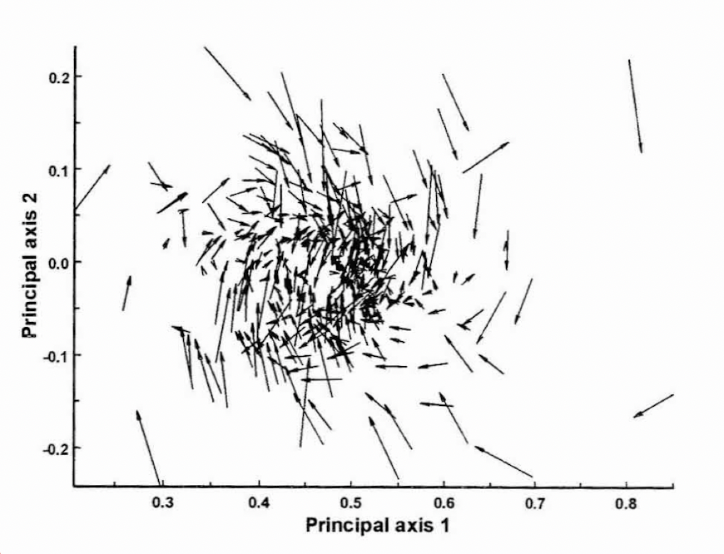
Results and The Attractor Part 2
Now with vectors representing both the direction to the following point and the largest distance between consecutive points.
Clockwise rotation around a central void.
Same bow-tie-like shape where the left lobe represents trials where bombing occurred but no avalanche was triggered, while the right lobe represents successfully triggered avalanches.
Notes:
Same two axis as previous graphs but with vector reprsentations

Slide 9
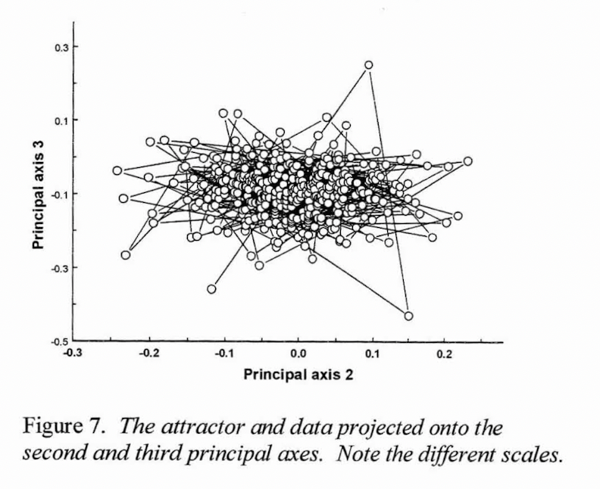
Results and The Attractor Part 3
Looking at the second and third dimensions.
This can be viewed from the right edge of the previous two figures.
Contrastingly, the rotation is counterclockwise, with the horizontal axis being exaggerated.
It further lacks the torus and bow-tie-like structure from the previous two figures.
Makes sense as the embedding dimension was at most three and via PCA the researchers concluded the first two PCs accounted for 70% of the variance with the third PC comprising most of the noise.
Notes:
As we determined our embedding dimension was at most three, we look at the second and third dimensions.
PC means principal component
Comprising most of the noise, which is what we see here

Slide 10
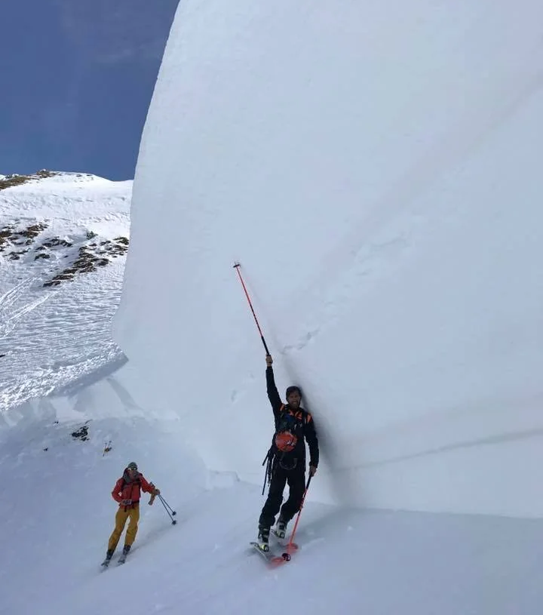
Discussion and Sources of Error and Variability
Caused by a fractal distribution of the terrain in the avalanche paths.
Small sample size:
Many of the statistical tests for chaos measuring the attractor and embedding dimension are built around the assumption of thousands of data points, while this dataset has 400.
An aperiodic orbit on a small dataset may be periodic if the data set were extended and larger.
Measurements:
Crown depth is estimated from far away by different observers.
Rounding crown depth to the nearest few inches.
Notes:
-
- Terrain: Deemed unlikely as the terrain contour of the mountain are very smooth and consistent.

Slide 11
Why Nothing About the Lyapunov Exponent
The researchers concluded that because the dataset was so small, calculations of Lyapunov exponents would be unreliable.
A study by Eckmann and Puelle, determined that the number of points required for reliable Lyapunov exponent calculations must be greater than the square of the number of points required for the correlation dimension. In this data that would mean 100,000 data points.
Notes:
Joke about wishing they would talk about the lyapnuv exponent
Separate proof
Take away is we really haven’t discussed this at all

Slide 12
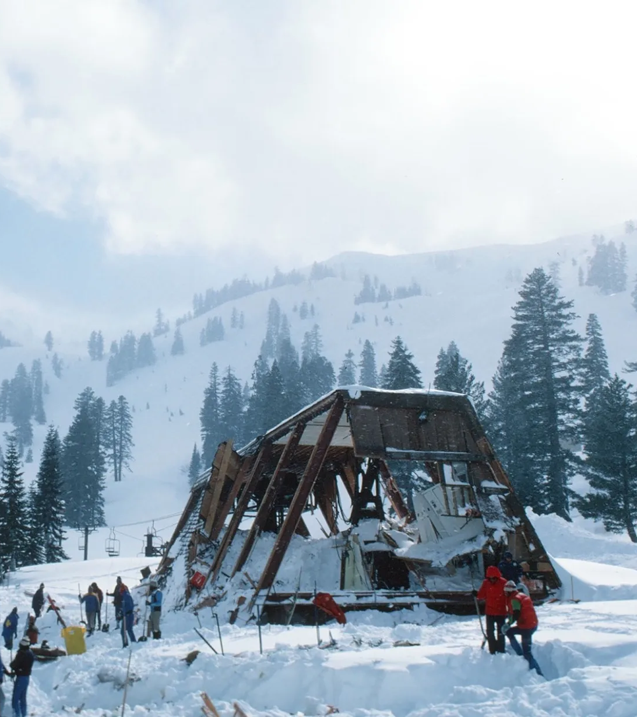
Why we Care
As slab avalanching is a chaotic process, long run modeling of slab build up and releasing will be incredibly poor.
By knowing that slab avalanches are chaotic, predictive models can be better created/adjusted hopefully reducing the hundreds of deaths and millions of dollars of damage caused by avalanches each year.
Notes:
, poor if not useless due to the SDIC and respective unpredictable divergence.
Thus, as we know whether models have these same problems, to improve our long range models, we would need to use probabilities on top of short run whether models to model the snow crystal shape etc.
Image is alpine meadows avalanche 1982, 7 dead when hit lodge

Slide 13
Link to Paper

